Slide 1
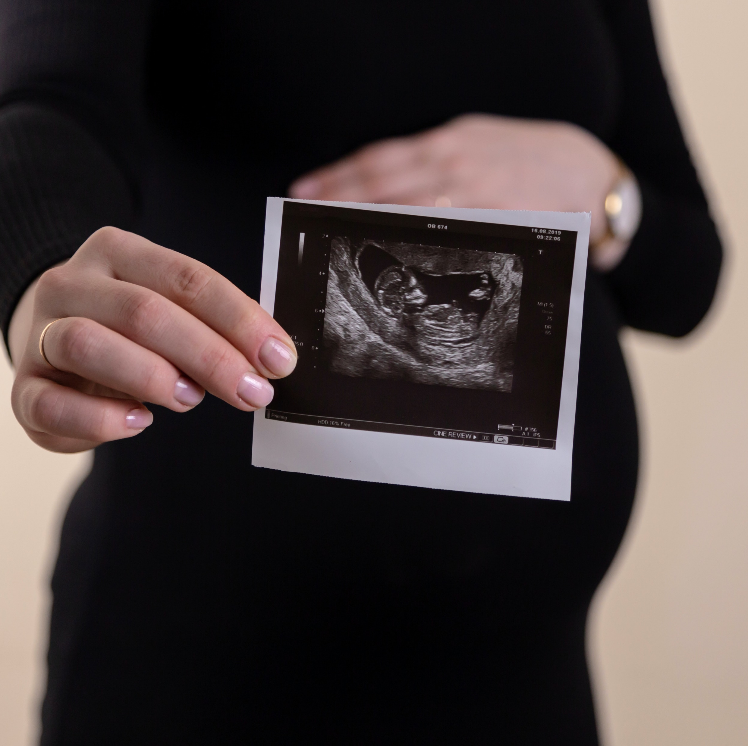
Developing a fetal classifier.
A data science project by Kenneth Imade
Photo by Volodymyr Hryshchenko on Unsplash

Slide 2

Objective
To develop a machine learning model capable of classifying fetus health into three categories; normal, suspect, or pathological
Evaluate the performance of various machine learning classifiers and choose the best one for classifying fetus health

Slide 3
Overview
Context
Reduction of child mortality is reflected in several of the United Nations' Sustainable Development Goals and is a key indicator of human progress. The UN expects that by 2030, countries end preventable deaths of newborns and children under 5 years of age, with all countries aiming to reduce under‑5 mortality to at least as low as 25 per 1,000 live births.
Parallel to notion of child mortality is of course maternal mortality, which accounts for 295 000 deaths during and following pregnancy and childbirth (as of 2017). The vast majority of these deaths (94%) occurred in low-resource settings, and most could have been prevented.
In light of what was mentioned above, Cardiotocograms (CTGs) are a simple and cost accessible option to assess fetal health, allowing healthcare professionals to take action in order to prevent child and maternal mortality. The equipment itself works by sending ultrasound pulses and reading its response, thus shedding light on fetal heart rate (FHR), fetal movements, uterine contractions and more.
Data Source: Fetal Health Classification | Kaggle
Acknowledgement: Ayres de Campos et al. (2000) SisPorto 2.0 A Program for Automated Analysis of Cardiotocograms. J Matern Fetal Med 5:311-318 (link)

Slide 4

Exploratory Data Analysis

Slide 5
Dataset Statistics
N = 2,126 | Mean | Std | Min | 25% | 50% | 75% | Max
Baseline value | 133.303857 | 9.840844 | 106.0 | 126.000 | 133.000 | 140.000 | 160.000
Accelerations | 0.003178 | 0.003866 | 0.0 | 0.000 | 0.002 | 0.006 | 0.019
Fetal movement | 0.009481 | 0.046666 | 0.0 | 0.000 | 0.000 | 0.003 | 0.481
Uterine contractions | 0.004366 | 0.002946 | 0.0 | 0.002 | 0.004 | 0.007 | 0.015
Light decelerations | 0.001889 | 0.002960 | 0.0 | 0.000 | 0.000 | 0.003 | 0.015
Severe decelerations | 0.000003 | 0.000057 | 0.0 | 0.000 | 0.000 | 0.000 | 0.001
Prolongued decelerations | 0.000159 | 0.000590 | 0.0 | 0.000 | 0.000 | 0.000 | 0.005
Abnormal short term variability | 46.990122 | 17.192814 | 12.0 | 32.000 | 49.000 | 61.000 | 87.000
Mean value of short term variability | 1.332785 | 0.883241 | 0.2 | 0.700 | 1.200 | 1.700 | 7.000
Percentage of time with abnormal long term variability | 9.846660 | 18.396880 | 0.0 | 0.000 | 0.000 | 11.000 | 91.000
Mean value of long term variability | 8.187629 | 5.628247 | 0.0 | 4.600 | 7.400 | 10.800 | 50.700

Slide 6
Dataset Statistics Continued
N = 2,126 | Mean | Std | Min | 25% | 50% | 75% | Max
Histogram width | 70.445908 | 38.955693 | 3.0 | 37.000 | 67.500 | 100.000 | 180.000
Histogram min | 93.579492 | 29.560212 | 50.0 | 67.000 | 93.000 | 120.000 | 159.000
Histogram max | 164.025400 | 17.944183 | 122.0 | 152.000 | 162.000 | 174.000 | 238.000
Histogram number of peaks | 4.068203 | 2.949386 | 0.0 | 2.000 | 3.000 | 6.000 | 18.000
Histogram number of zeroes | 0.323612 | 0.706059 | 0.0 | 0.000 | 0.000 | 0.000 | 10.000
Histogram mode | 137.452023 | 16.381289 | 60.0 | 129.000 | 139.000 | 148.000 | 187.000
Histogram mean | 134.610536 | 15.593596 | 73.0 | 125.000 | 136.000 | 145.000 | 182.000
Histogram median | 138.090310 | 14.466589 | 77.0 | 129.000 | 139.000 | 148.000 | 186.000
Histogram variance | 18.808090 | 28.977636 | 0.0 | 2.000 | 7.000 | 24.000 | 269.000
Histogram tendency | 0.320320 | 0.610829 | -1.0 | 0.000 | 0.000 | 1.000 | 1.000
Fetal health (Target Variable) | 1.304327 | 0.614377 | 1.0 | 1.000 | 1.000 | 1.000 | 3.000

Slide 7

What is the distribution of the target variable?

Slide 8
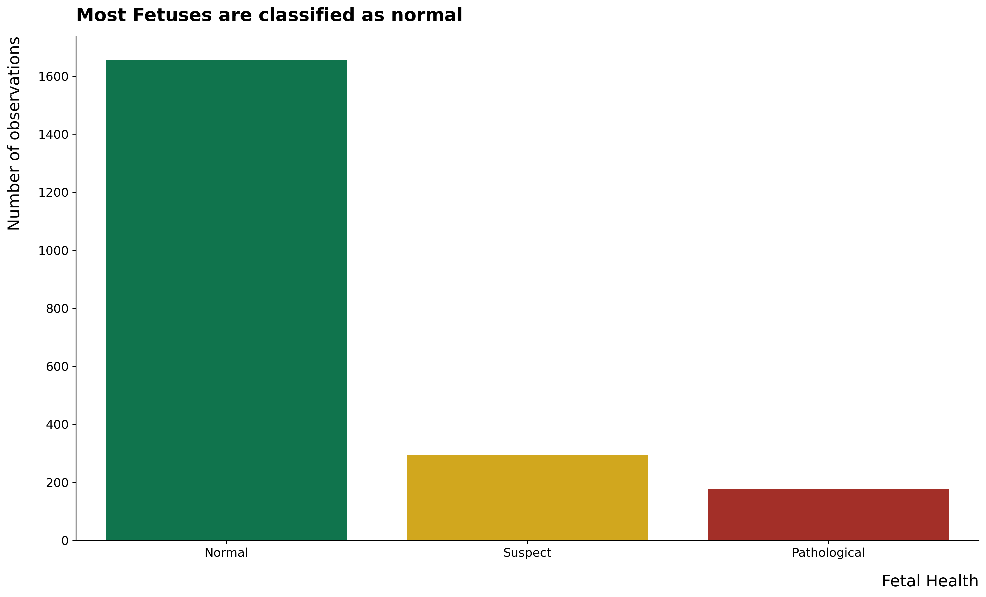

Slide 9
What is the relationship between the target variable and other variables?

Slide 10
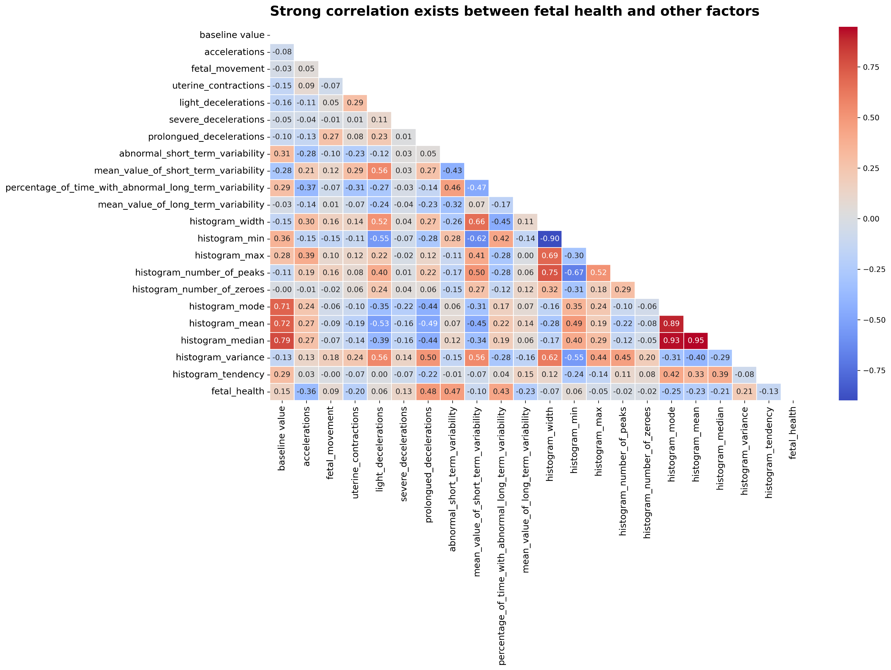

Slide 11
How does Fetal health change with respect to these variables?

Slide 12
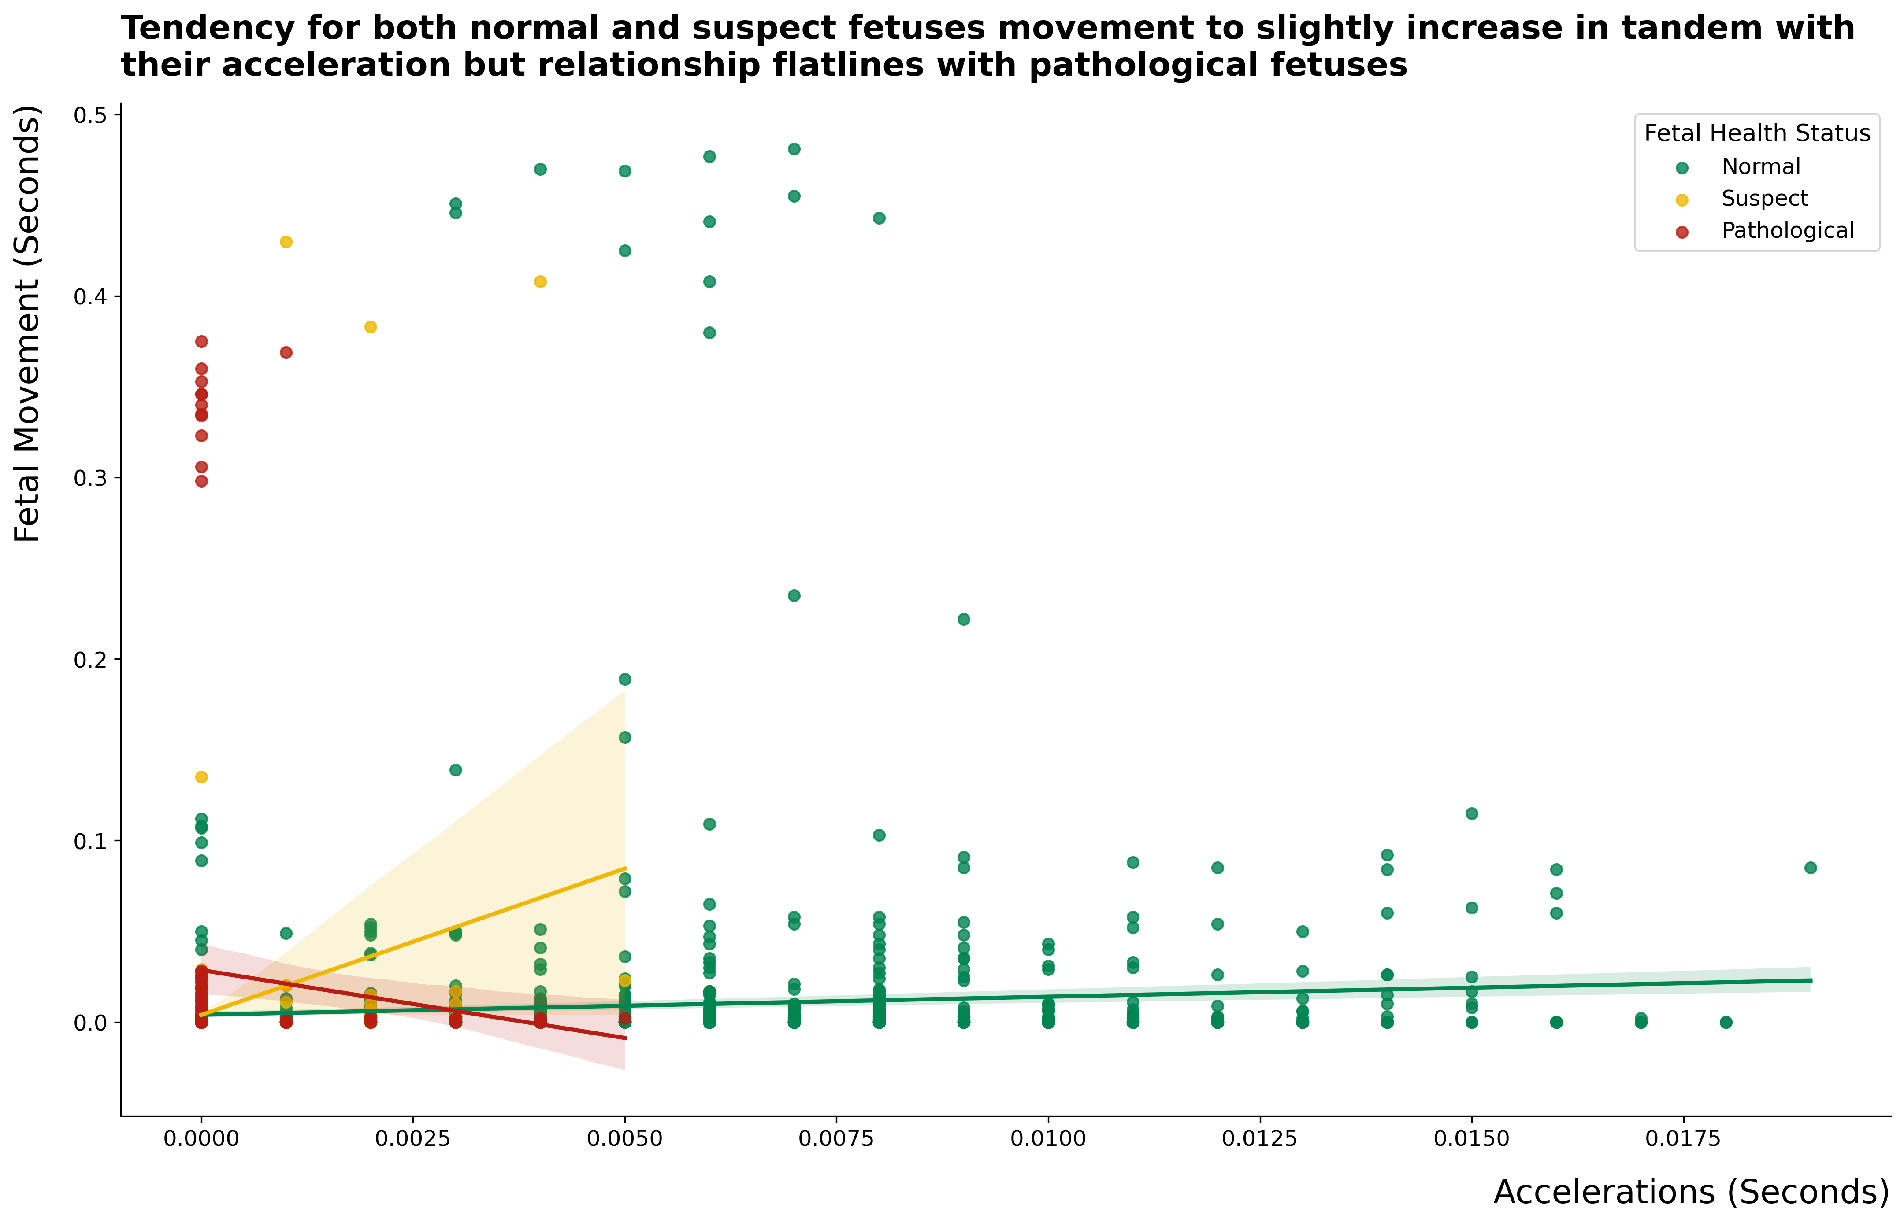

Slide 13
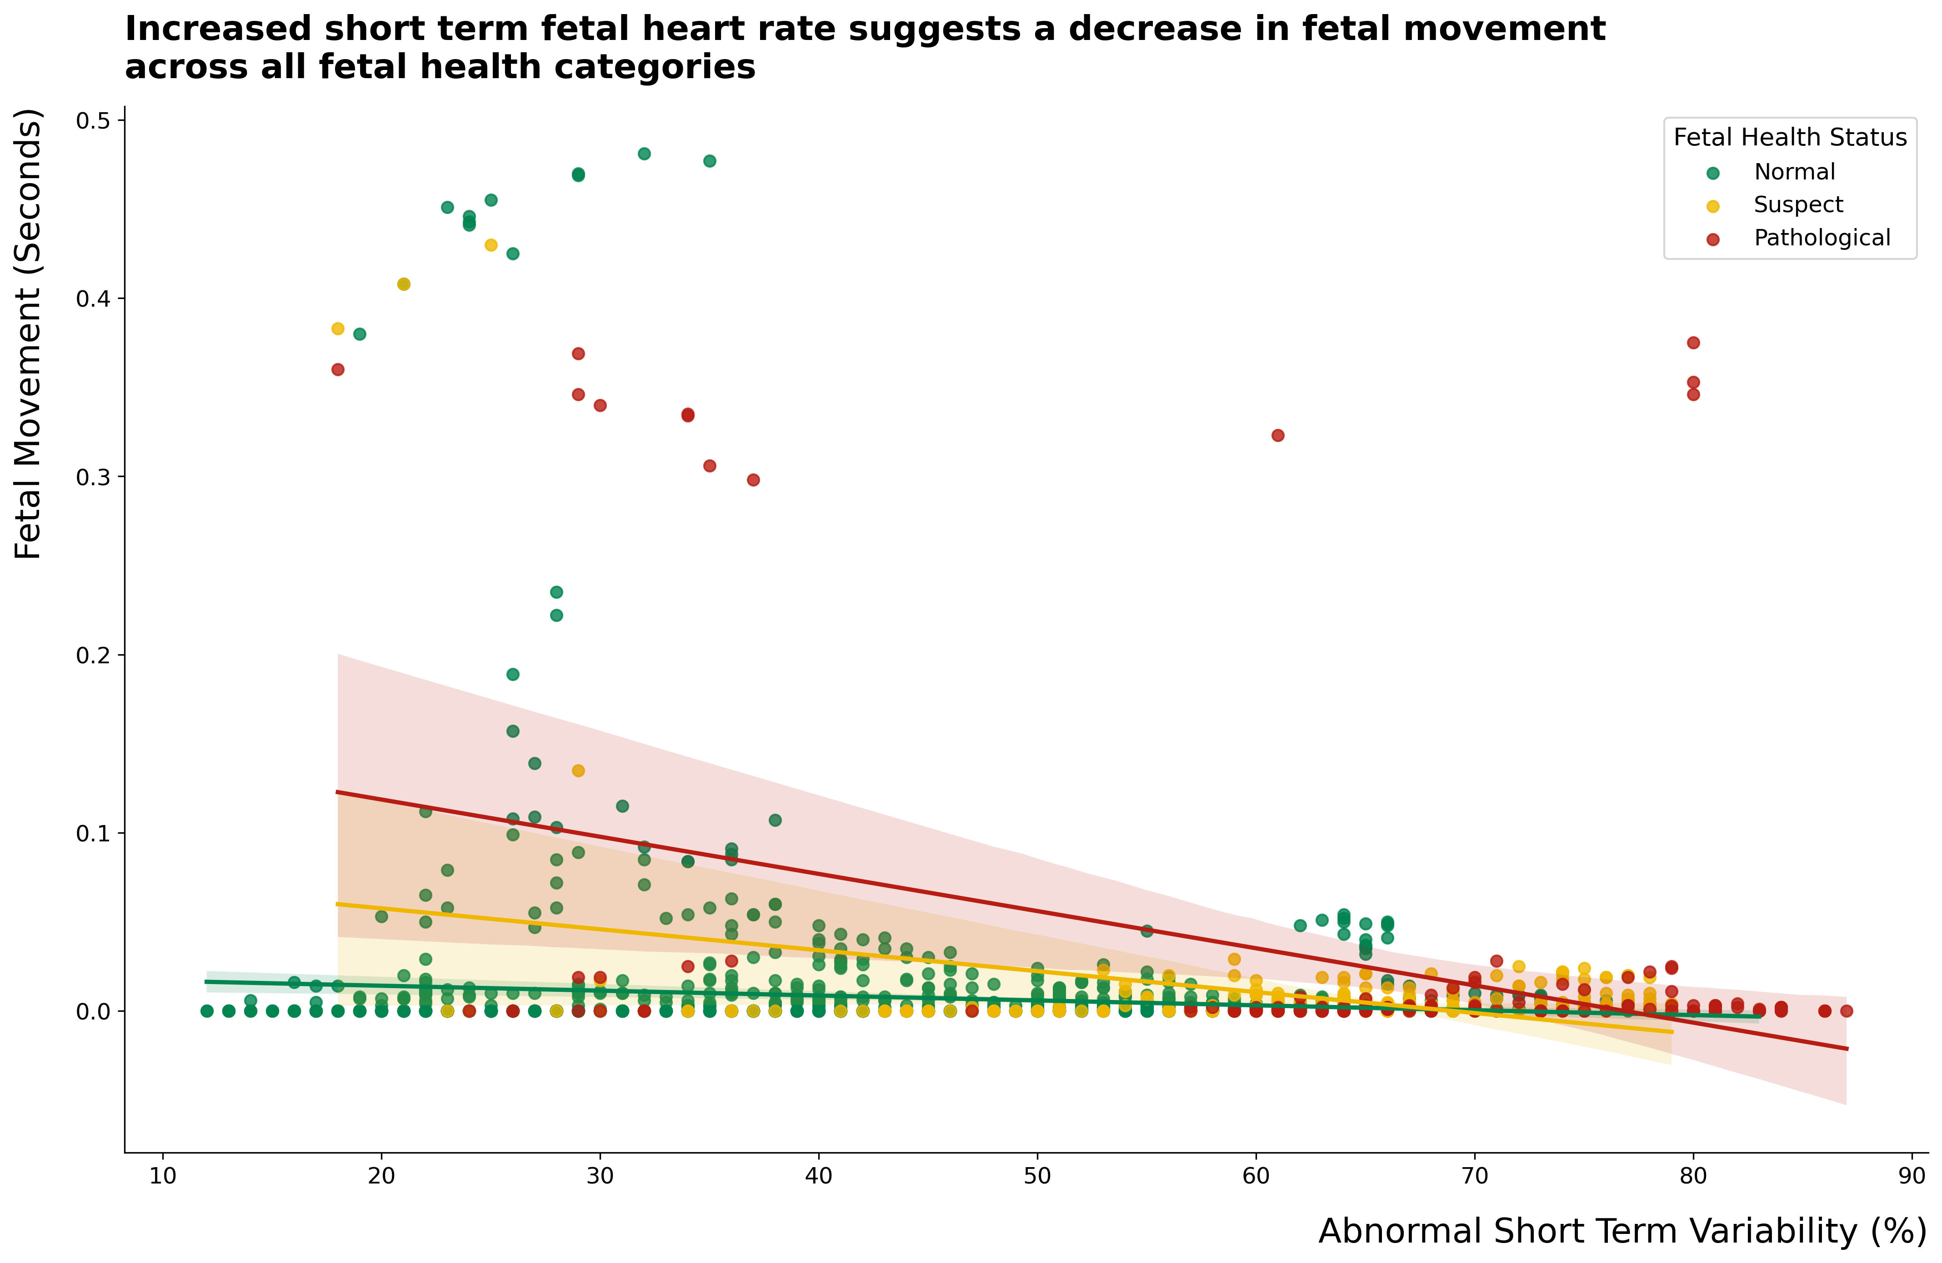

Slide 14
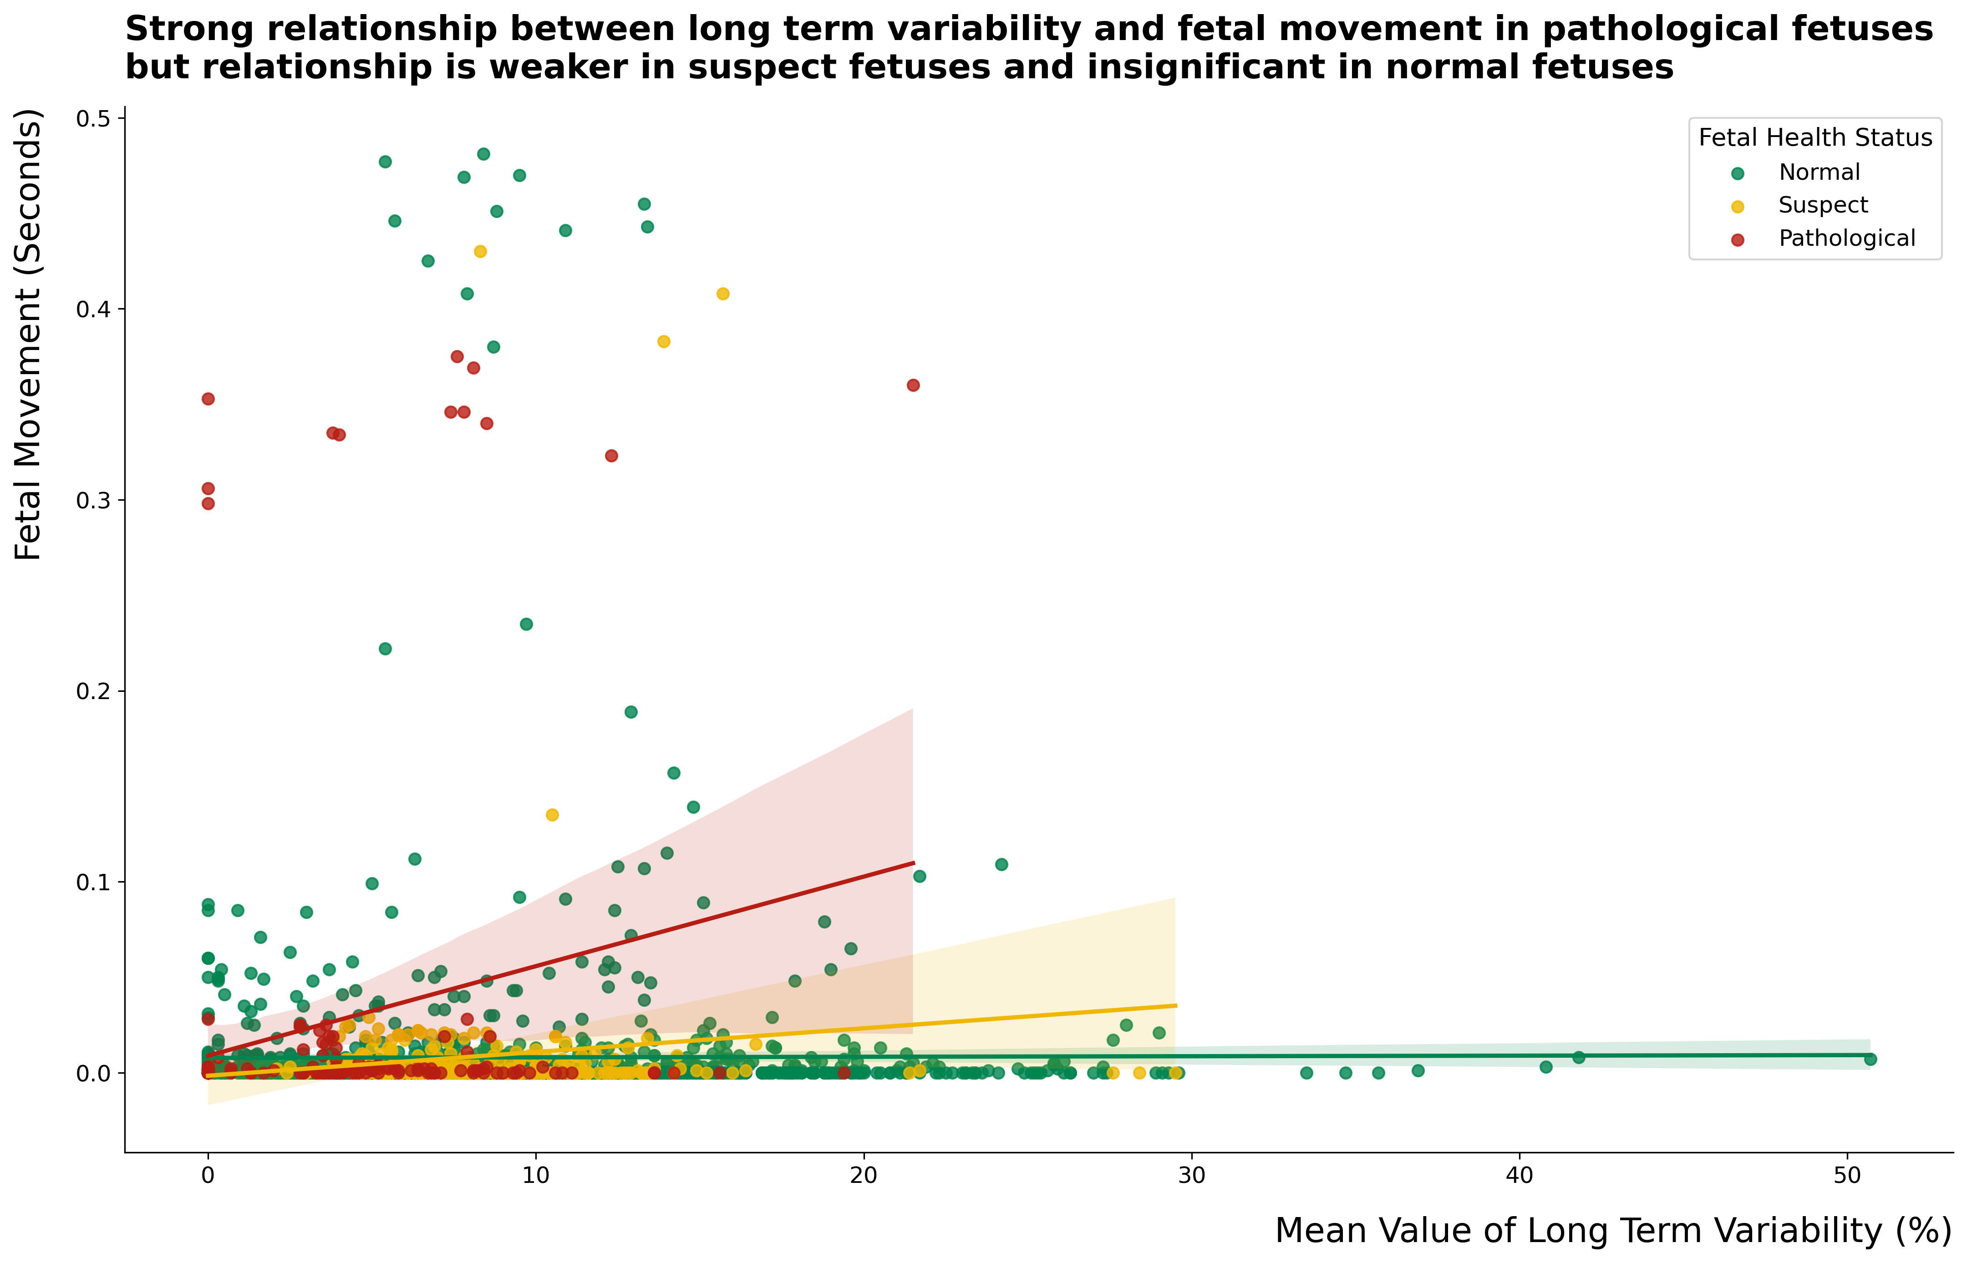

Slide 15
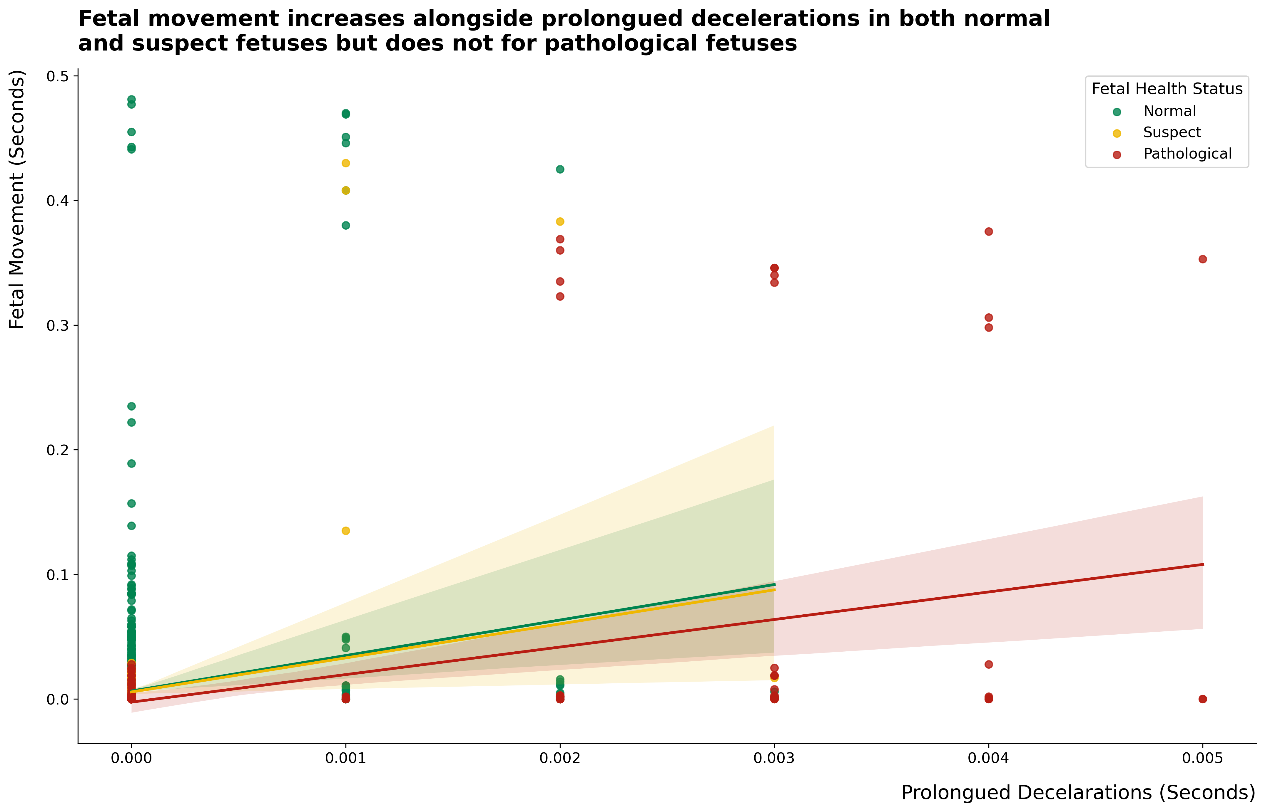

Slide 16

Data preprocessing and model building

Slide 17
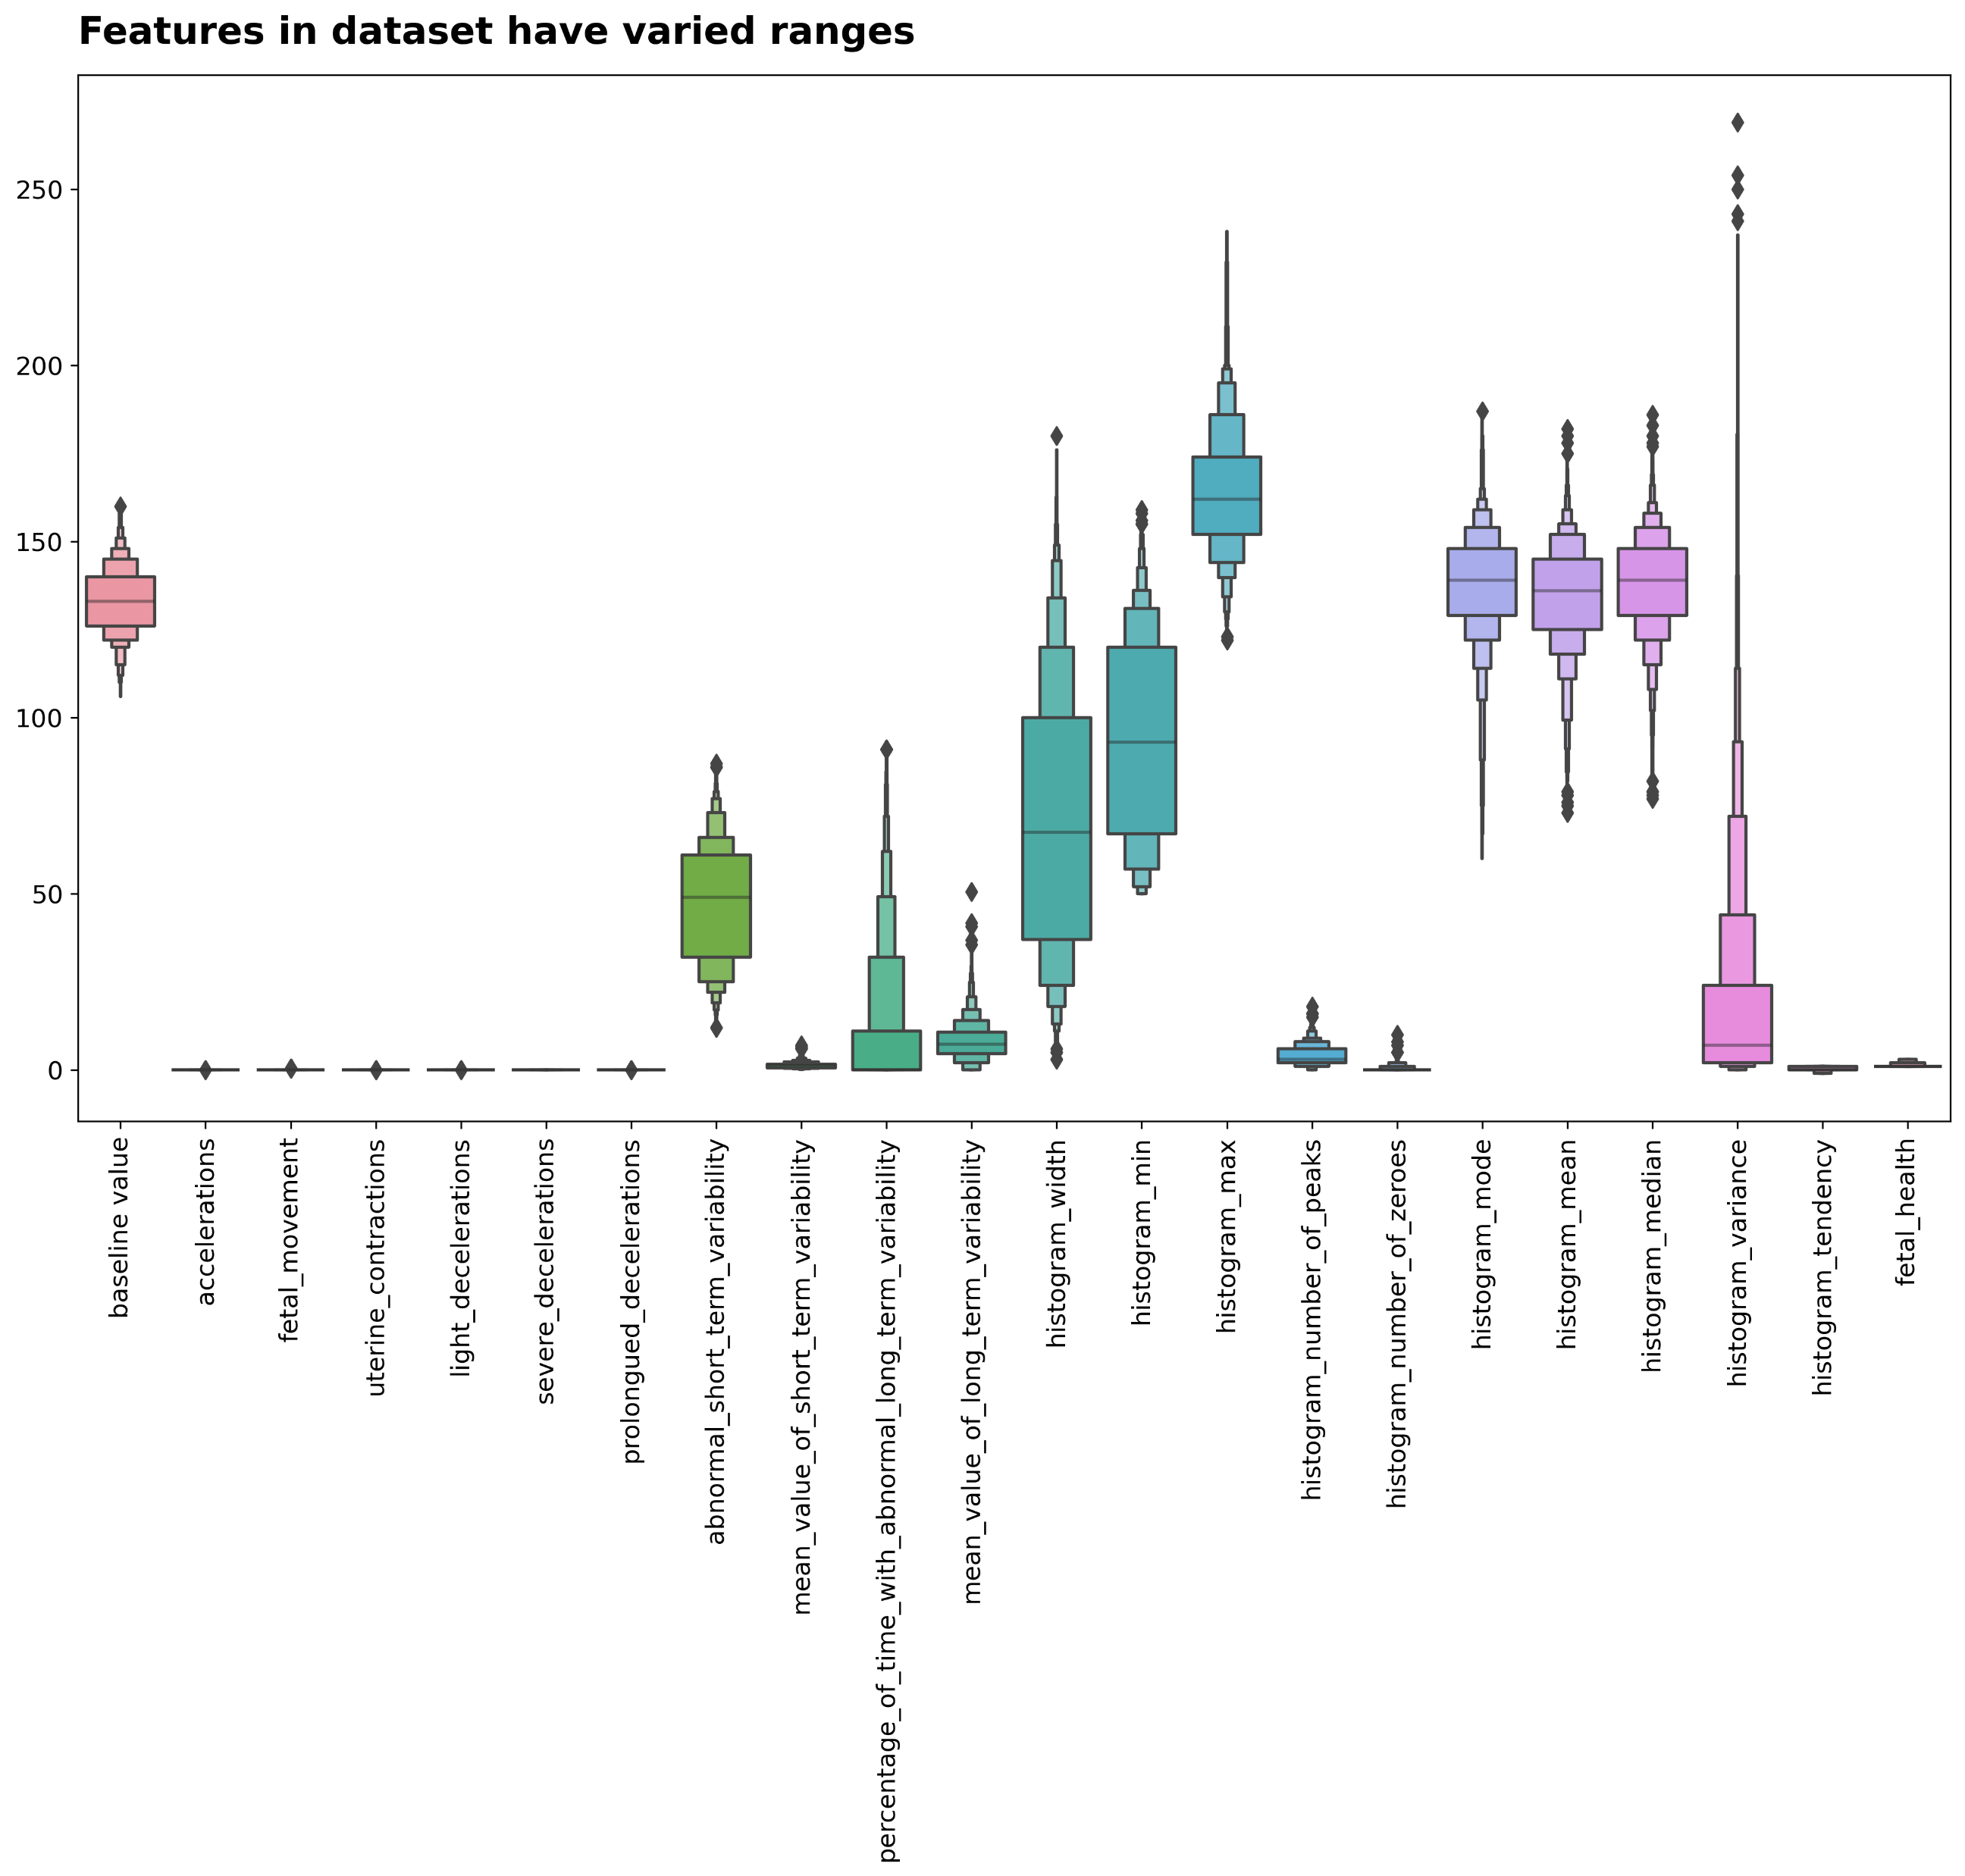

Slide 18
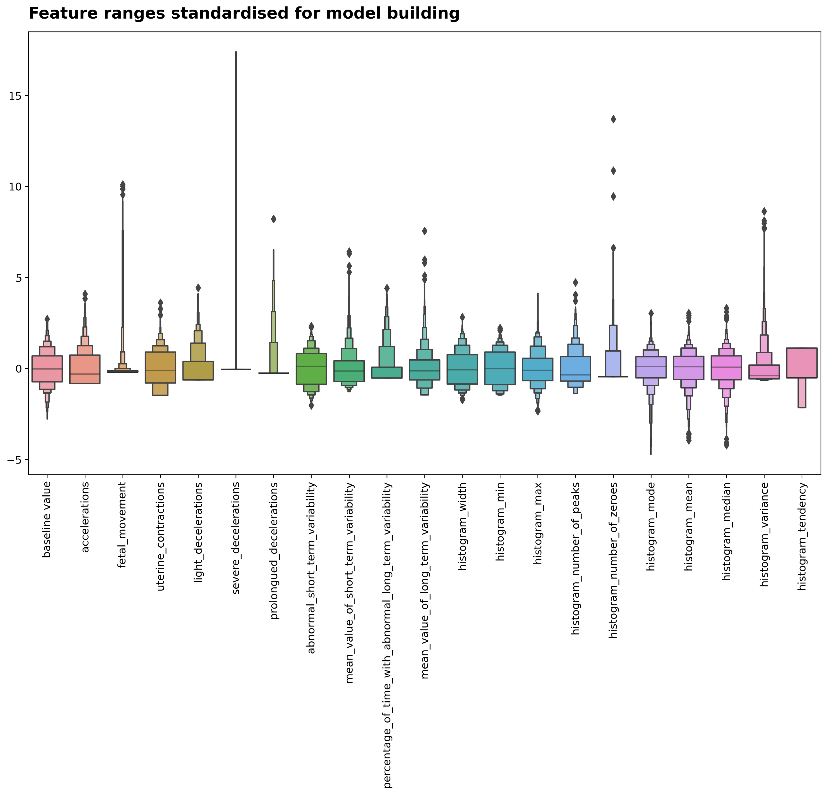

Slide 19
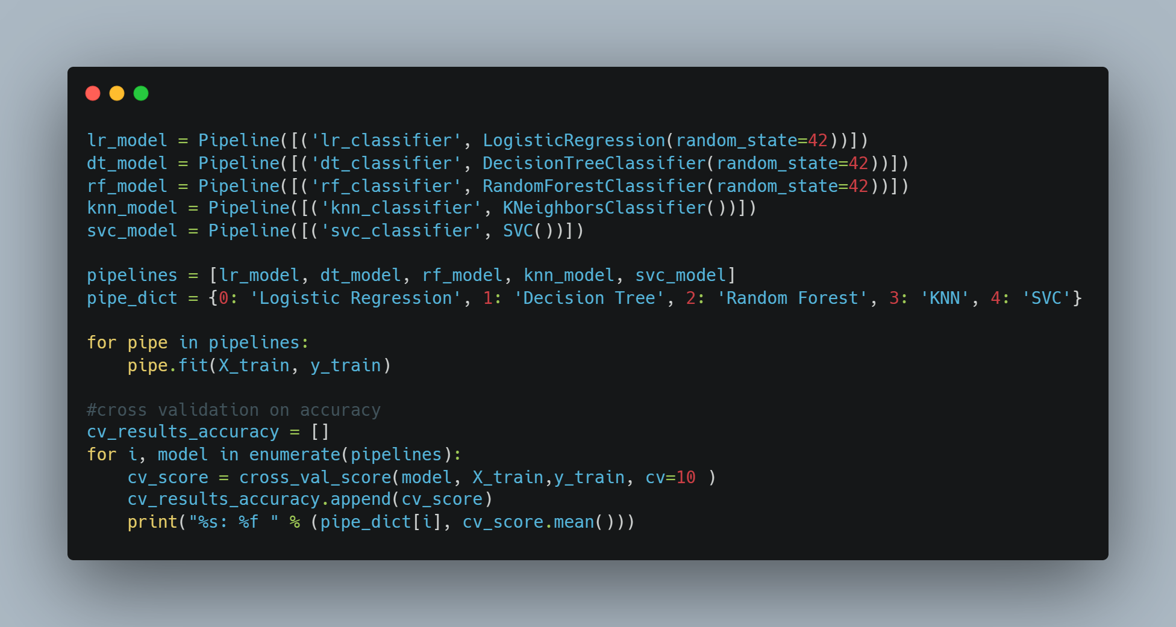
Choosing the best model

Slide 20
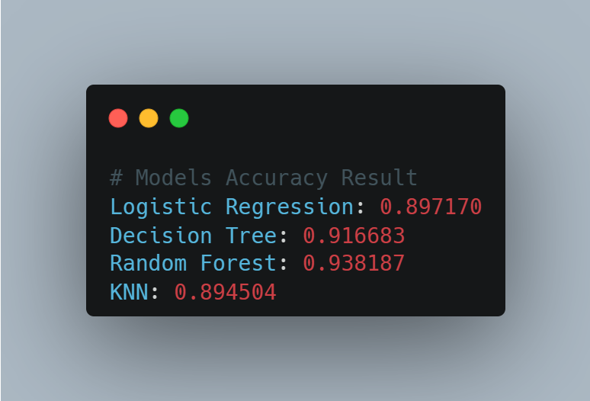
Classification models accuracy result

Slide 21
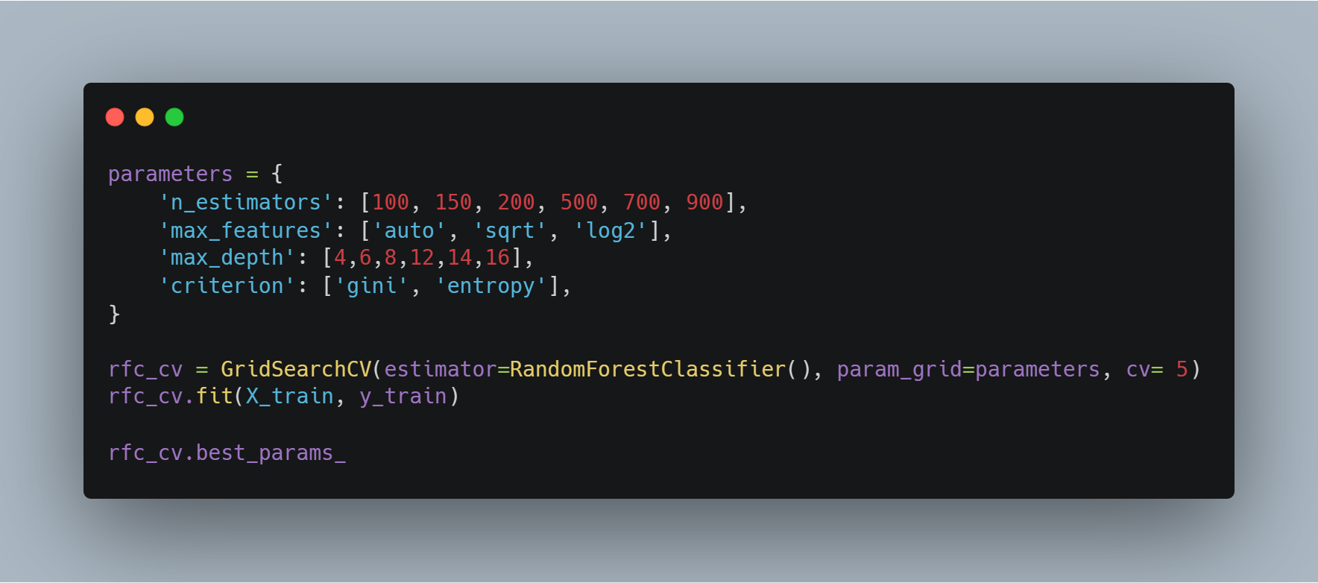
Hyper-parameter tuning

Slide 22

Results

Slide 23
Classification Metrics
 | Precision | Recall | F1-Score | Support
Normal (1.0) | 0.96 | 0.98 | 0.97 | 496
Suspect (2.0) | 0.92 | 0.78 | 0.84 | 101
Pathological (3.0) | 0.88 | 0.93 | 0.90 | 41
Accuracy |  |  | 0.95 | 638
Macro Avg | 0.92 | 0.90 | 0.91 | 638
Weighted Avg | 0.95 | 0.95 | 0.95 | 638

Slide 24
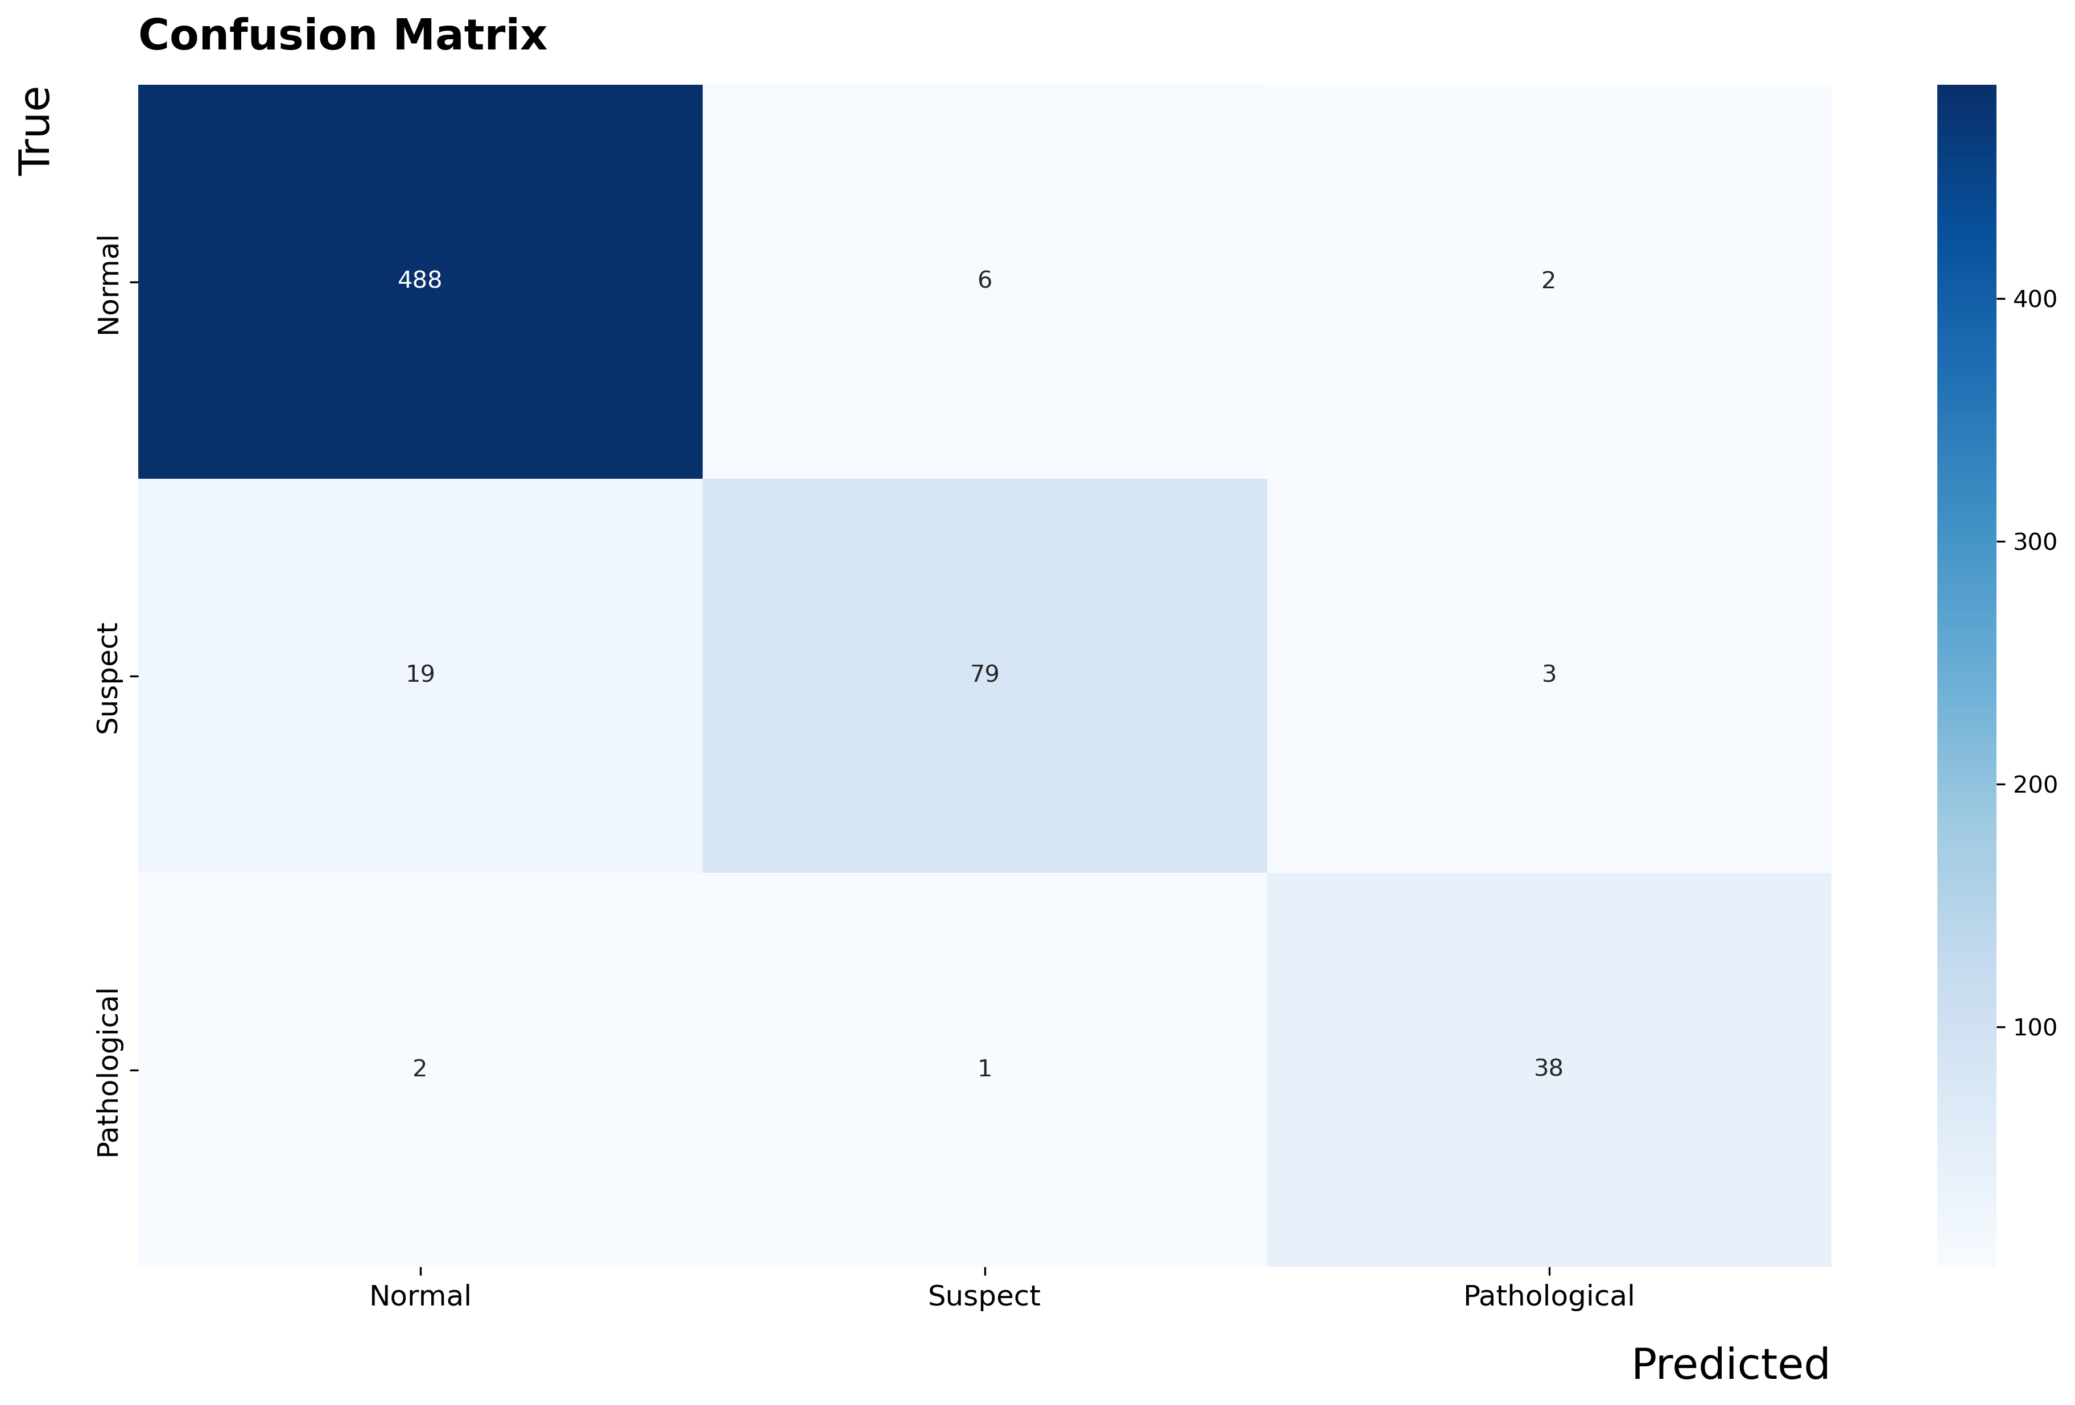

Slide 25
Conclusion
The best model was found to be the Random Forest Classifier. The model is most accurate with the 'Normal' class, with a high number of correct predictions and a relatively small number of false predictions. The model performs reasonably well on the 'Pathological' class. The 'Suspect' class has the most misclassifications relative to its true count, with a notable number of false negatives (predicted as 'Normal').

